Slide 1

Unit 3

Slide 2
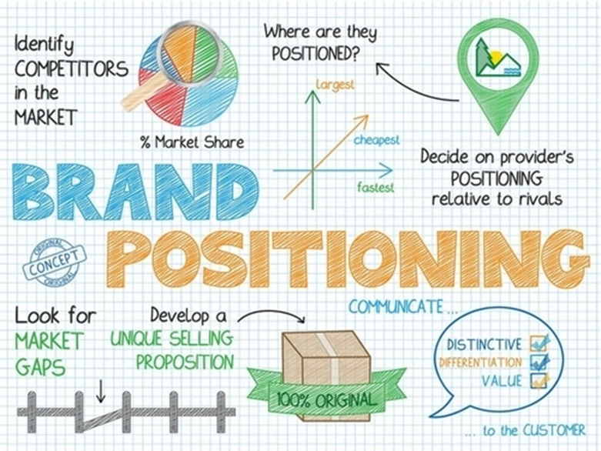
Brand positioning refers to the unique value that a brand presents to its customer. It is a marketing strategy brands create to establish their brand identity while conveying their value proposition, which is the reason why a customer would prefer their brand over others.

Slide 3
Brand Positioning Statement
When creating a brand positioning statement, it is important to consider the following:
Who is the target market or customer?
What is your product or service category?
What is the greatest benefit and impact of your product or service?
What is the proof of that benefit and impact?

Slide 4
How do you create a brand positioning strategy?
Understand how your brand is currently positioning itself.
Determine your unique value proposition.
Identify your competitors and their positioning.
Create your positioning statement.
Evaluate and test whether your positioning works.
Reinforce your brand’s differentiating qualities.

Slide 5
Importance of Brand Positioning and Strategy
Market differentiation
Justifies the pricing strategy
Competitive advantage
Makes the brand more creative

Slide 6

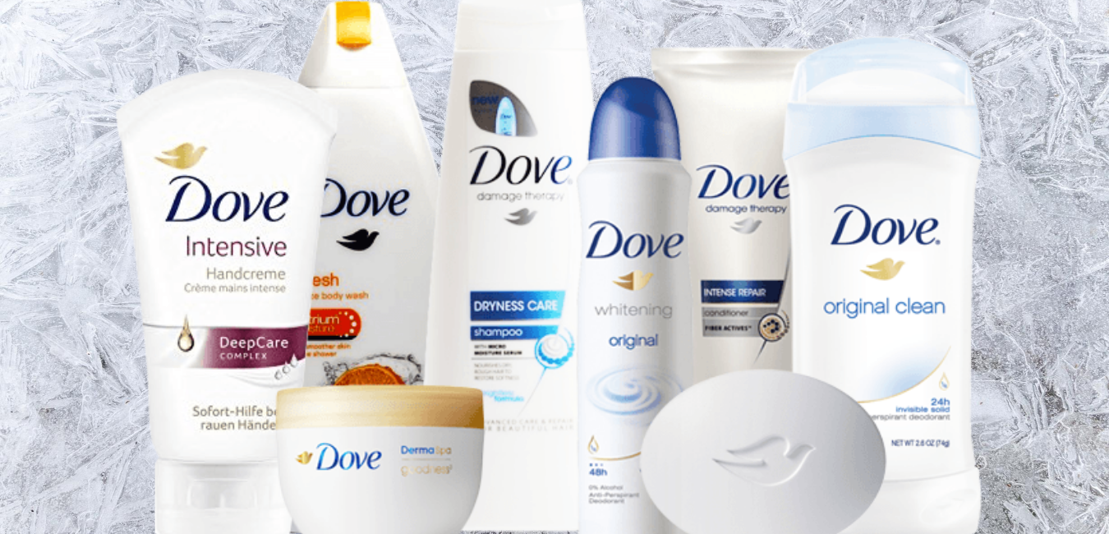
Dove’s Brand Positioning

Slide 7
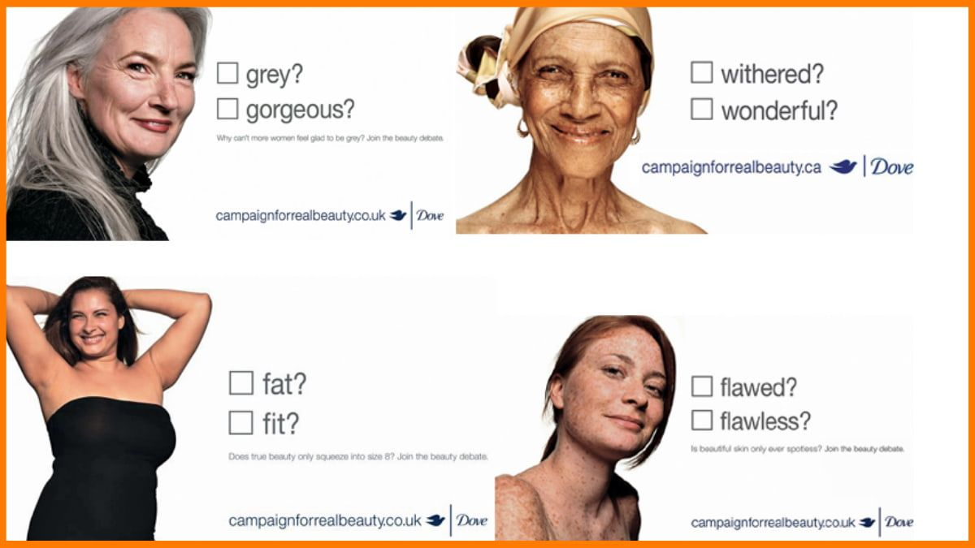
The main aim of Dove's marketing strategy is to promote real beauty among women

Slide 8
Types of Brand Positioning Strategies
Quality based Brand positioning
Competitor based positioning
Benefit positioning
Problem and solution positioning
Price Positioning
Celebrity-driven positioning
Leader-based positioning

Slide 9
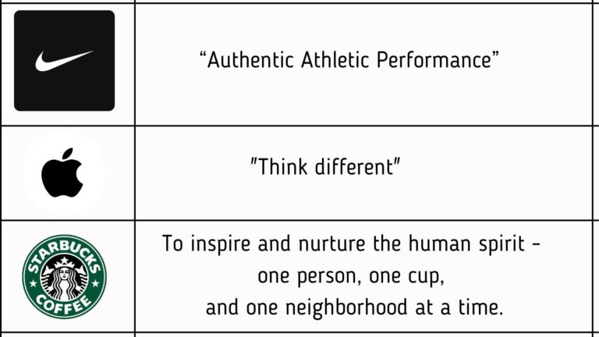
Brand Mantra
Brand mantra is said to be a message that tends to capture the brand’s essence and improves the position of the brand in the market place.

Slide 10
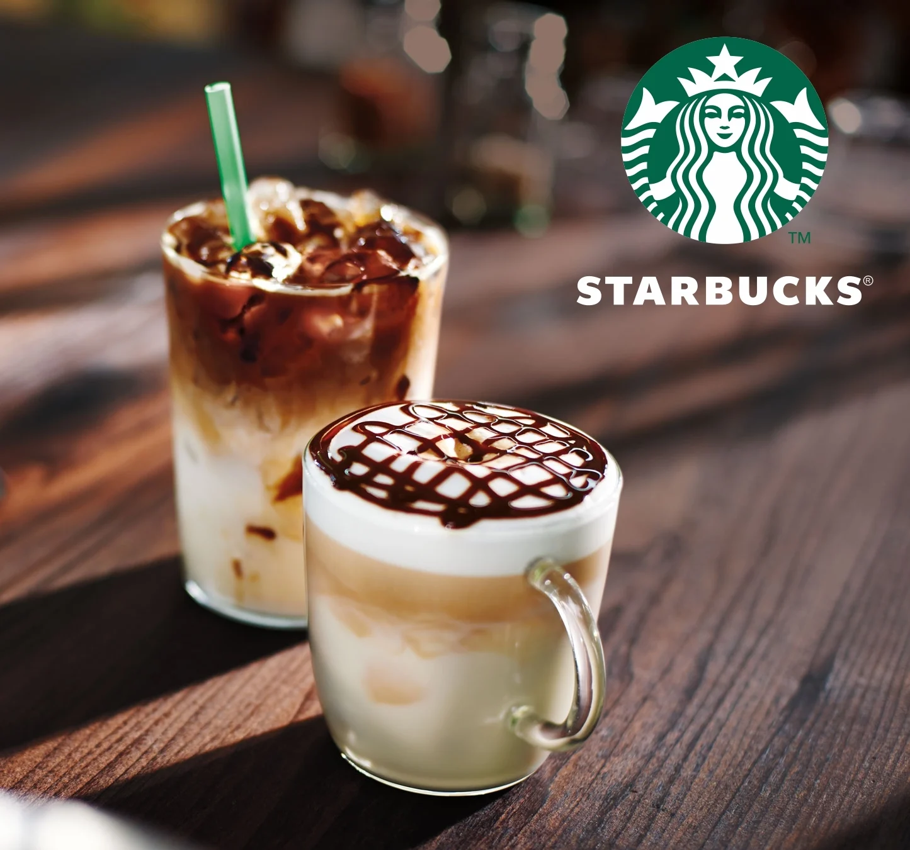
Starbucks President and CEO of Howard Schultz
“Success is not sustainable if it is defined by how big you become. Large numbers that once captivated me – 40,000 stores – are not what matters. The only number that matters is ‘one’. One cup. One customer. One partner. One experience at a time”.

Slide 11

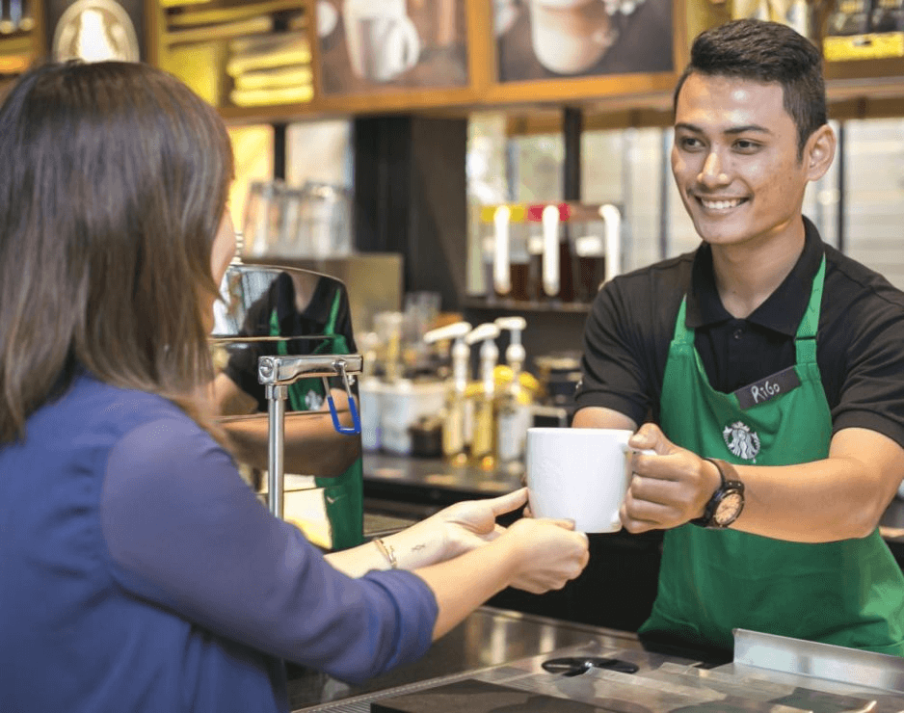

Slide 12
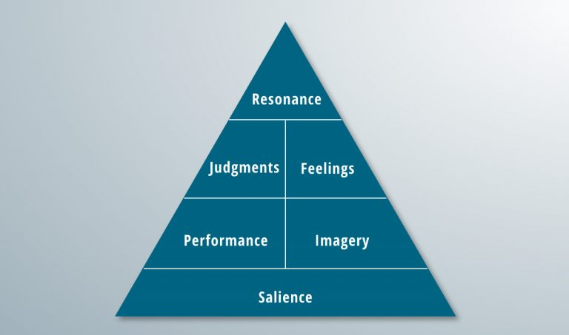
What is brand resonance?
Brand resonance is how well a customer relates to a branded element, such as a retail product. It is how someone perceives a brand and their values or goals. Brand resonance models are used to help build relationships with customers.

Slide 13
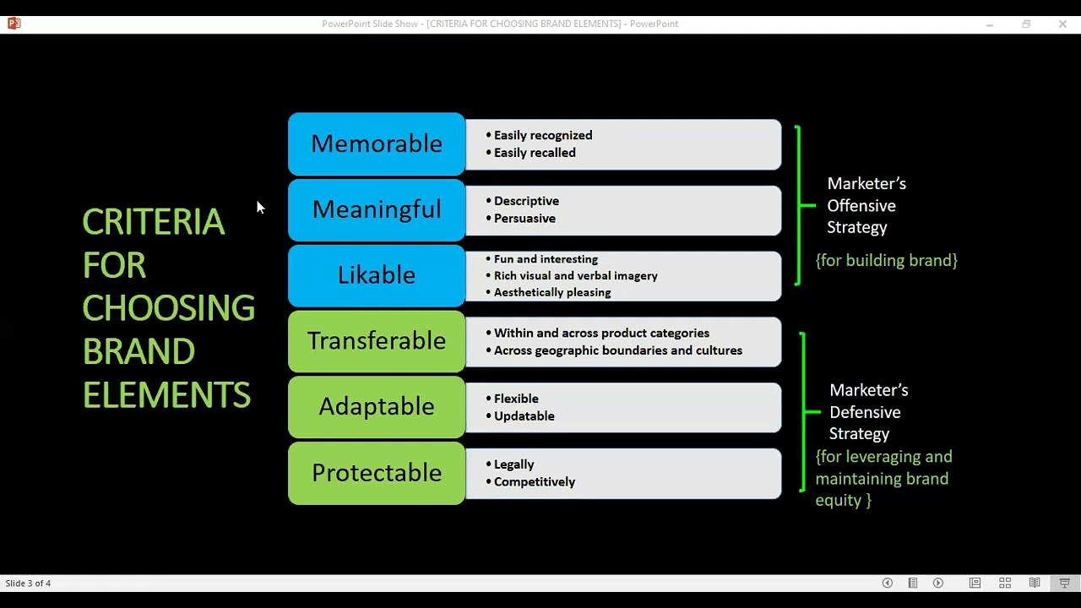

Slide 14
LEVERAGING SECONDARY BRAND ASSOCIATIONS TO BUILD BRAND EQUITY
Countries
Countries of origin and other geographic areas
Channels of distribution
Co-branding
Characters through licensing

Slide 15

Companies

Slide 16
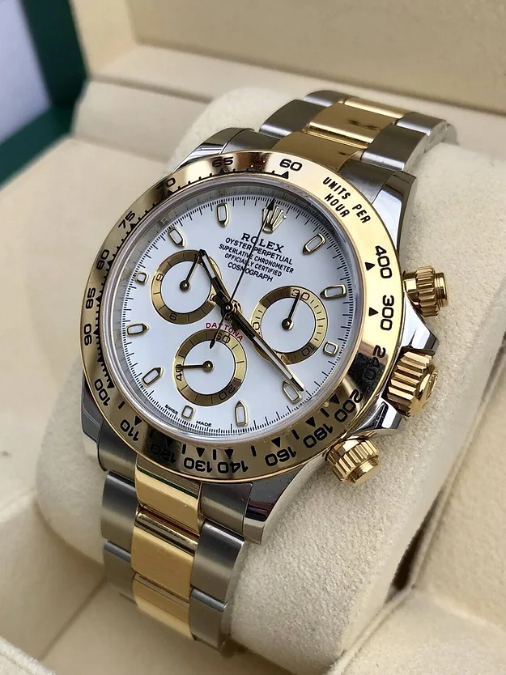
Country of Origin and other Geographical Areas

Slide 17
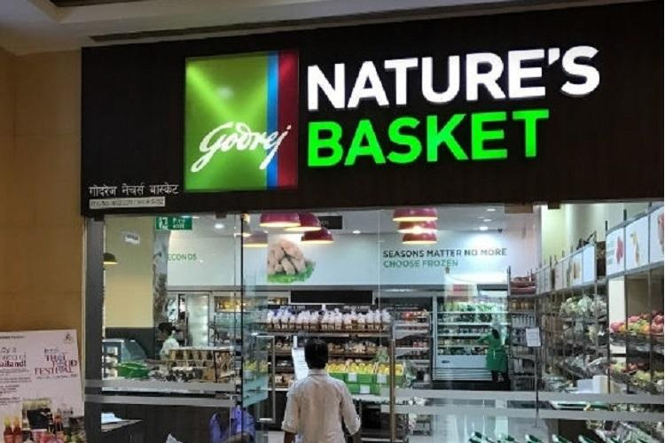
Channels of Distribution

Slide 18

Co-branding

Slide 19
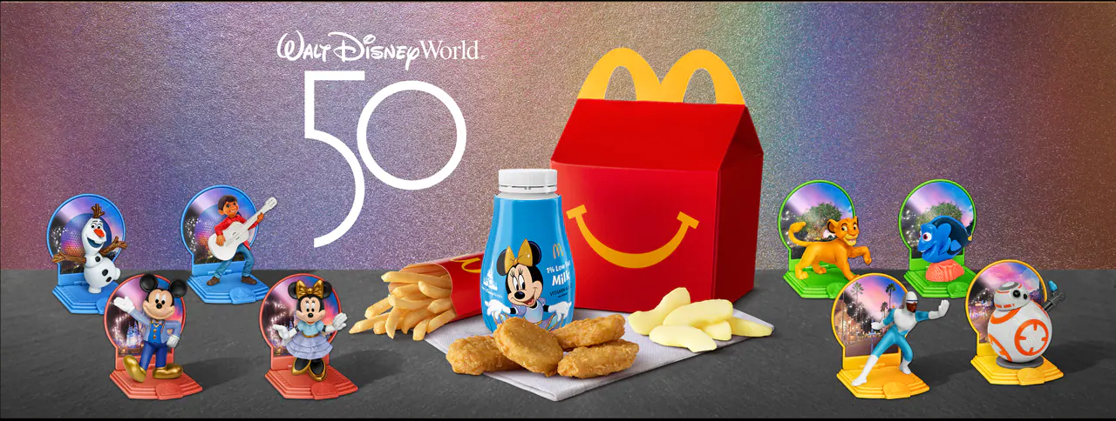
Characters through Licensing

